Slide 1
AI and Code: Two Projects from GitHub Next
Don Syme (dsyme@github.com) + all of GitHub Next
Principal Researcher, GitHub Next

Slide 2

GitHub Next
Researching the future of software development
githubnext.com

Slide 3
What is GitHub Next?
What
An applied R&D group attached to GitHub, reports to CEO of GitHub
Mission
Transform the practice of software development
Mode of Operation
Build, Release, Learn, Co-operate.
Who
~15 applied LLM/ML experts (many ex-Copilot), UX experts, CS experts
Why this is the right way to run innovative applied R&D
Operates at the Goldilocks distance!

Slide 4
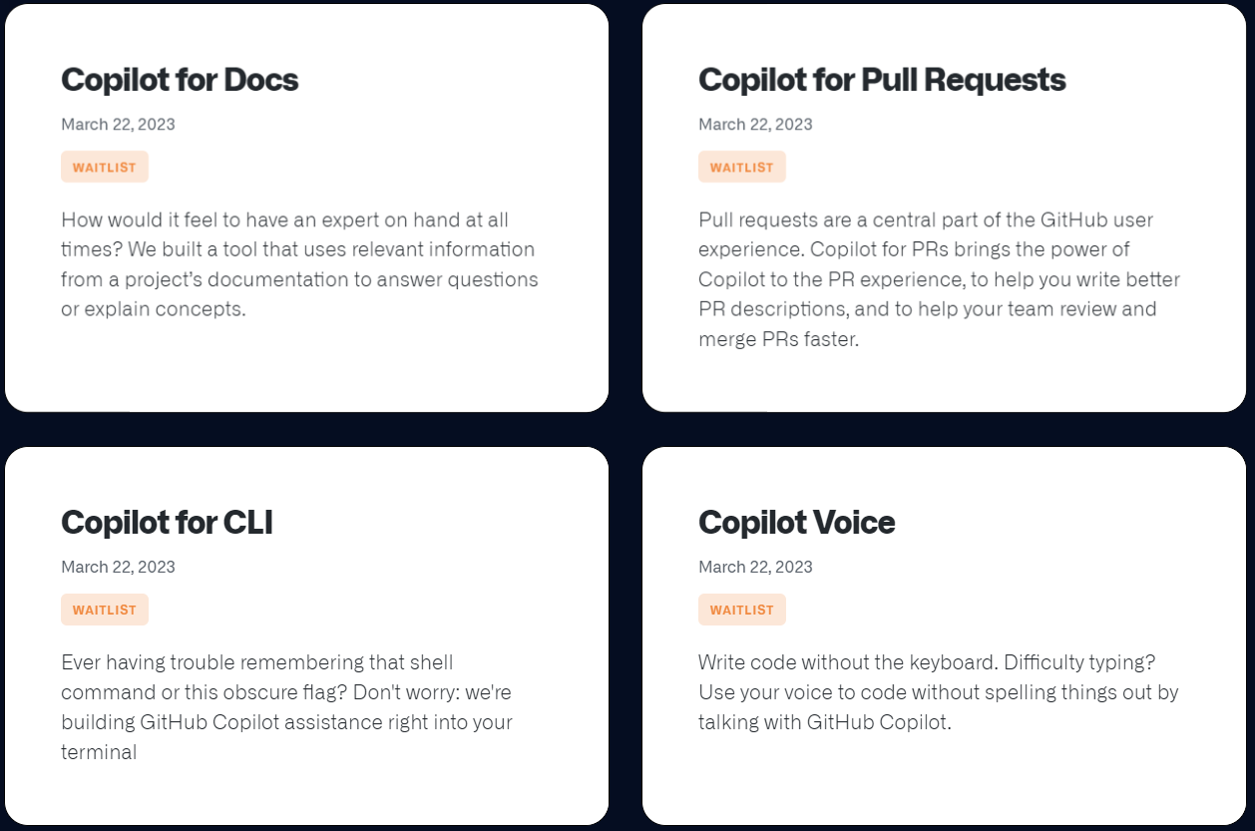
Released March 23!

Slide 5
Today’s Menu
Equipping GPT-4 with Numeric Calculation
Interlude
Towards pervasive summarization in GitHub

Slide 6
Part 1 - Equipping GPT-4 with Numeric Calculation
github.com/githubnext/gpt4-with-calc

Slide 7
caveat
Lots and lots of related work

Slide 8
Equipping for Numeric Calculation
The situation:
Any GPT-4 Chat: Context + Question ⇒ Answer

Slide 9
Equipping for Numeric Calculation
The situation:
Any GPT-4 Chat: Context + Question ⇒ Answer
The problem:
GPT-4 is terrible at numeric calculations
It’s also terrible at numeric comparisons
GPT-4 should not be trusted to write a number that is not present verbatim in the input, nor to reason about numbers in any significant way. In trust scenarios, don't allow GPT-4 to write numbers, and beware that every numeric comparison may be flawed.

Slide 10
How bad is this?
It’s bad

Slide 11
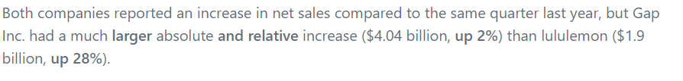

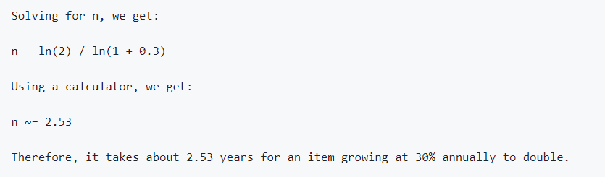
Example fails
Comparing financial documents
Example problem:
More example problem:

Slide 12
The Hope
The observation:
👎GPT-4 is terrible at numeric calculations
👍GPT-4 is good at writing numeric calculation code

Slide 13
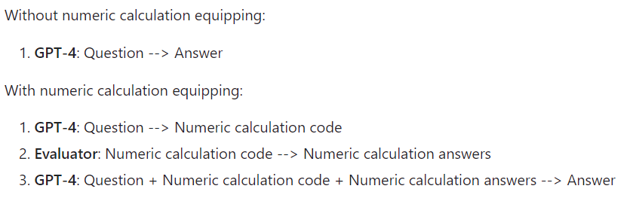
The Hope made Real
My opinion: this two-phase technique should be incorporated into every GPT-4 request that involves numbers unless explicitly known to be calculation-free. Anything else is

Slide 14
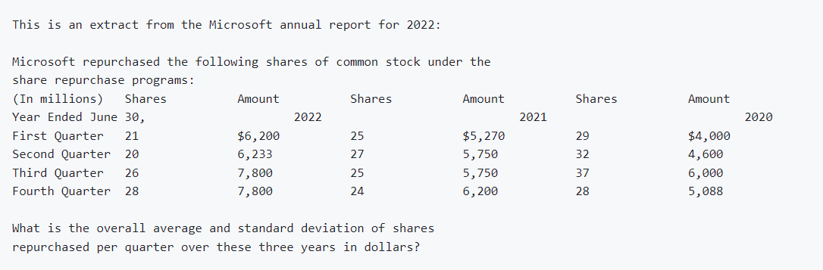
Example question

Slide 15
Example fail

Slide 16
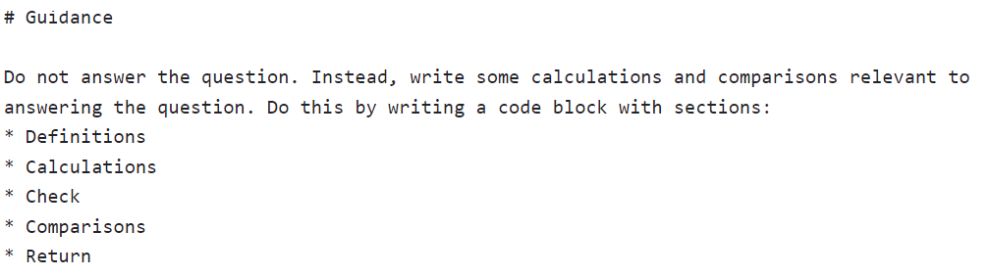
Example prompt

Slide 17
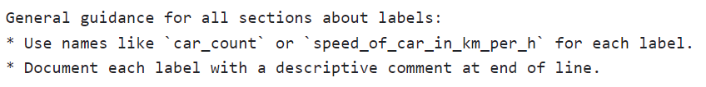
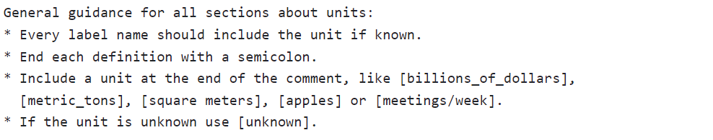
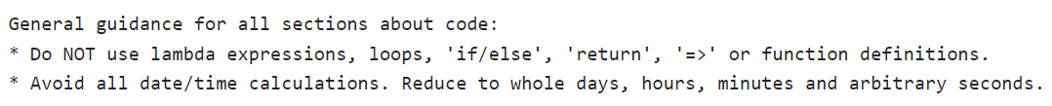

Example prompt

Slide 18
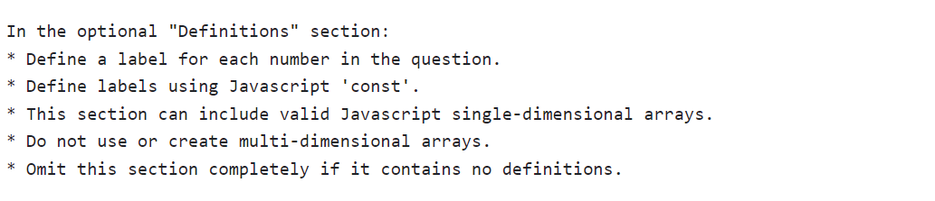
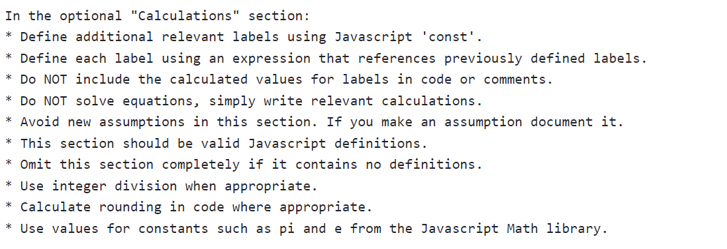
Example prompt

Slide 19
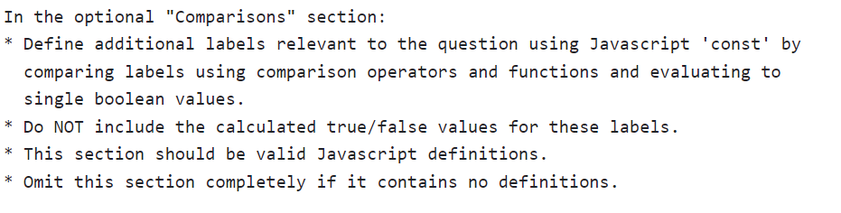
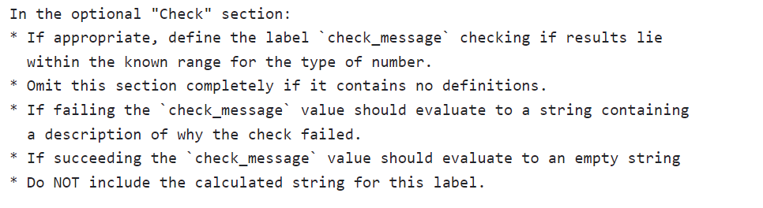
Example prompt

Slide 20
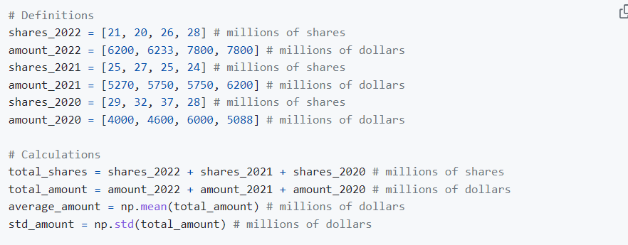
Example relevant calculation code

Slide 21
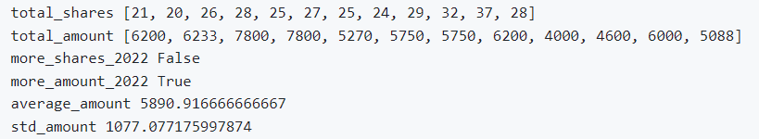
Example relevant results
Add code + results to the prompt, before the question

Slide 22
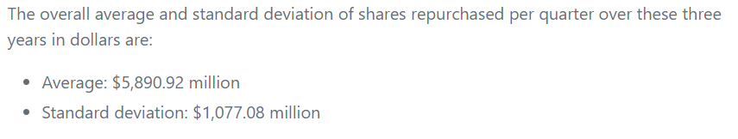
Example answer

Slide 23
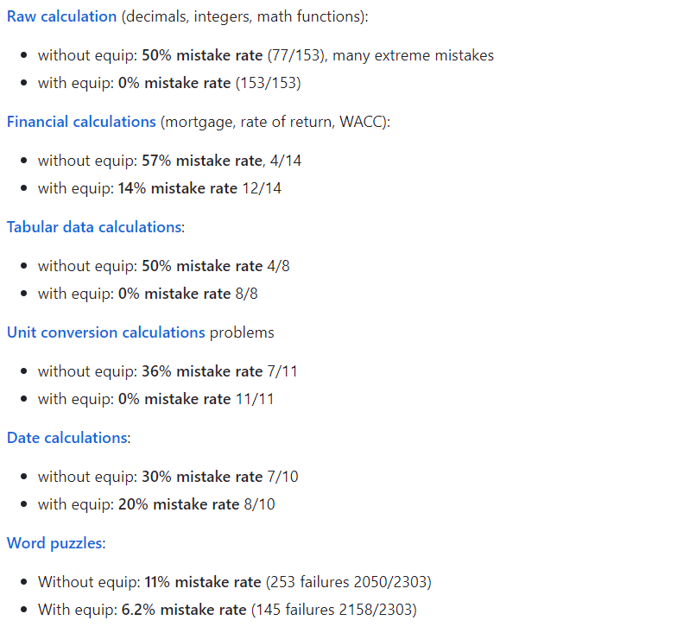
Effective?

Slide 24
Some mantras
Calculation is hard (for AI). Writing calculation code is (relatively) easy.
Computation is hard (for AI). Writing code is (relatively) easy.
(“Hey AI bro, you need that code after all?”)

Slide 25
Bonus topics
It’s not just calc, it’s comparisons too
Units of measure can be extracted and “tracked”
Self-checks
Commenting your calculations matters

Slide 26
Numeric calculation is the “hello world” of trustworthy systems
Numbers are always “rational”

Slide 27
INTERLUDE:
CAVEAT EMPTOR!

Slide 28
Welcome to the Future
The integration of Chat, Data and Programming is coming very fast. Much faster than I expected even a month ago.
Important: chat is not just one thing:
Chat for Entertainment
Chat for Search
Chat for Analytical Question Answering
Chat for Technical Creation
Chat for Tax Returns

Slide 29
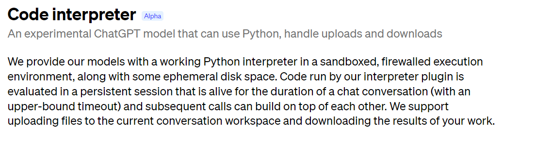
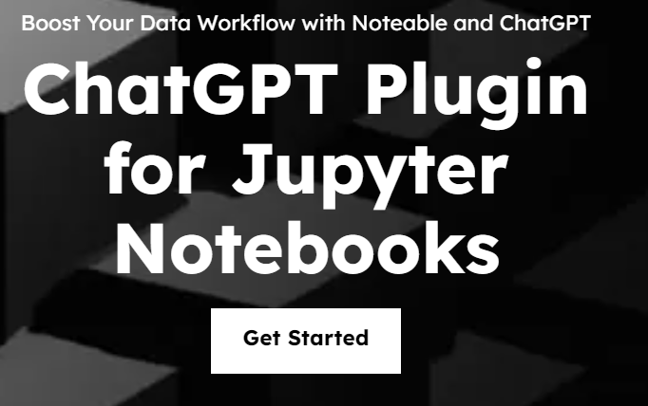
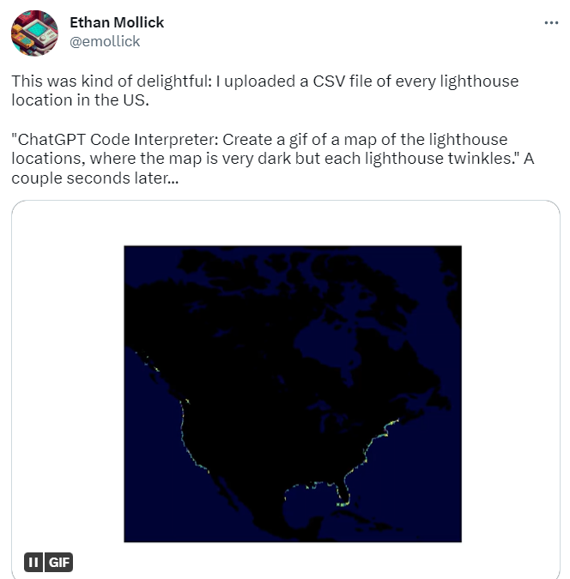
“Code Interpreter” ChatGPT AddIn

Slide 30
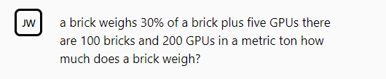
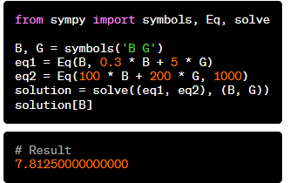
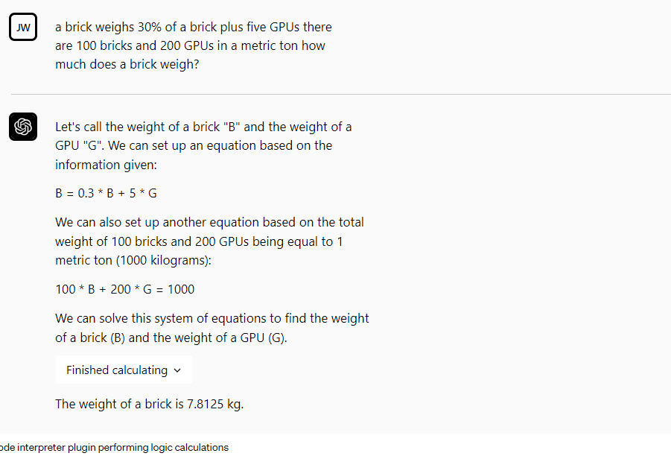

Slide 31
What’s Truly Needed for Trustworthy Chat?
The industry is crying out for AI that can be trusted, can be explained, can generate trustworthy, recognisable, analyzable artifacts like spreadsheets and notebooks.
By generating calculation code, we have a stepping stone to this.

Slide 32
The Good News
This category of technique can be applied to any language, computational logic, DSL, query language, library, service or computational capability.
The outputs can be answers, code, notebooks, proofs, spreadsheets, projects, tests, documentation. And tax returns.

Slide 33

The Devil is in the Detail
Every step of an LLM can introduce hallucination.
Example: hallucinated numbers in calculation code

Slide 34
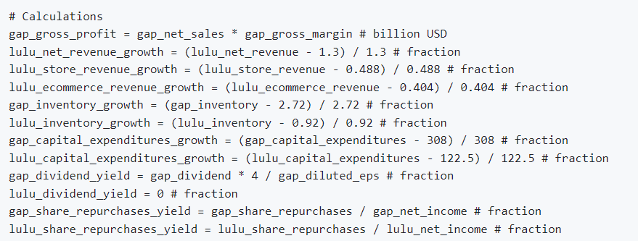

Slide 35
Questions for Today
Hardened, reliable, trustworthy calculation/reasoning systems are utterly critical
Proof, evidence, reasoning, explanation, audit, provenance and blame are critical in trust domains
In this world, code is much more ephemeral
What is “correct” code?
What is “evidence” that the chosen code or query is correct?
What hard engines help give establish trust and confidence?
What assumptions have been made?

Slide 36
Part 2 - Summaries in GitHub
githubnext.com/projects/copilot-for-pull-requests

Slide 37
Summarization: Rationale
We are headed to a world where most text associated with repos is emergent and automatic.
Content ⇒ Search Content ⇒ Text
Uses:
Abstracts, keywords, descriptions = for comprehension
Table of contents = for navigation
Documentation, walkthroughs = for explanation
Use cases:
Tool-tips Infopanel content
Seeding human-authored descriptions Search
Esp. when unfamiliar with content, pressed for time, or small-factor devices

Slide 38
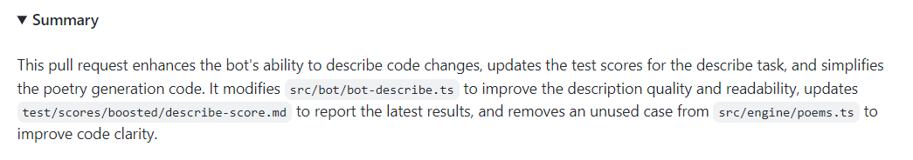
Example – PR Summary
./prbot describe https://github.com/githubnext/prbot/pull/565

Slide 39
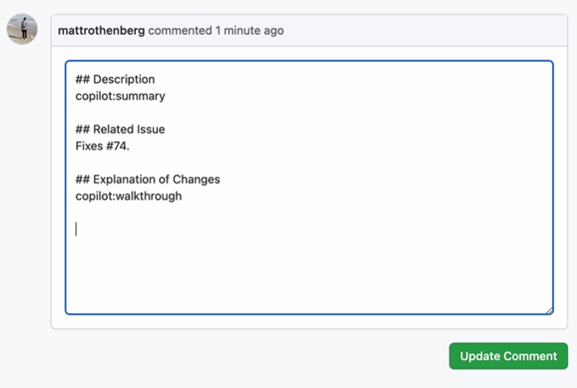

Slide 40
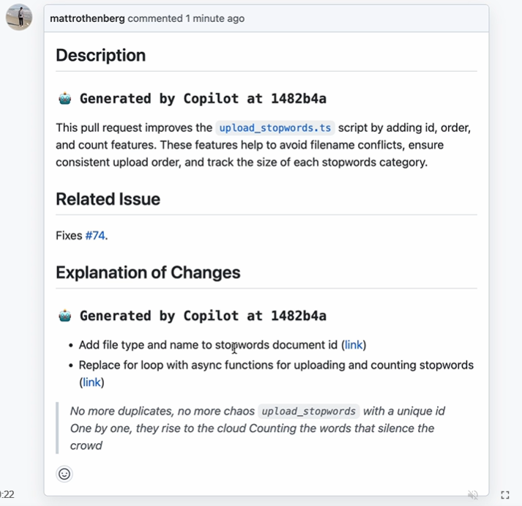

Slide 41
Final outputs
ΔOverall
ΔFiles
ΔFiles
ΔFile
ΔFile
ΔFile
ΔFile
ΔSnippet
ΔSnippet
ΔSnippet
ΔSnippet
ΔSnippet

Slide 42
Sample Prompts
ΔSnippet(s) → summary
ΔRepository → walkthrough

Slide 43

What about Hallucinations?

Slide 44
Hallucination Reduction in Summarization
Label all changes with “locators” for evidence
Requiring locators forces LLM to “ground” its text
Any change description without evidence is thrown away
Locators provide hyperlinks back to source
Small solitary changes hallucinate the most
Pack changes together
Don’t ask for long descriptions of small changes

Slide 45
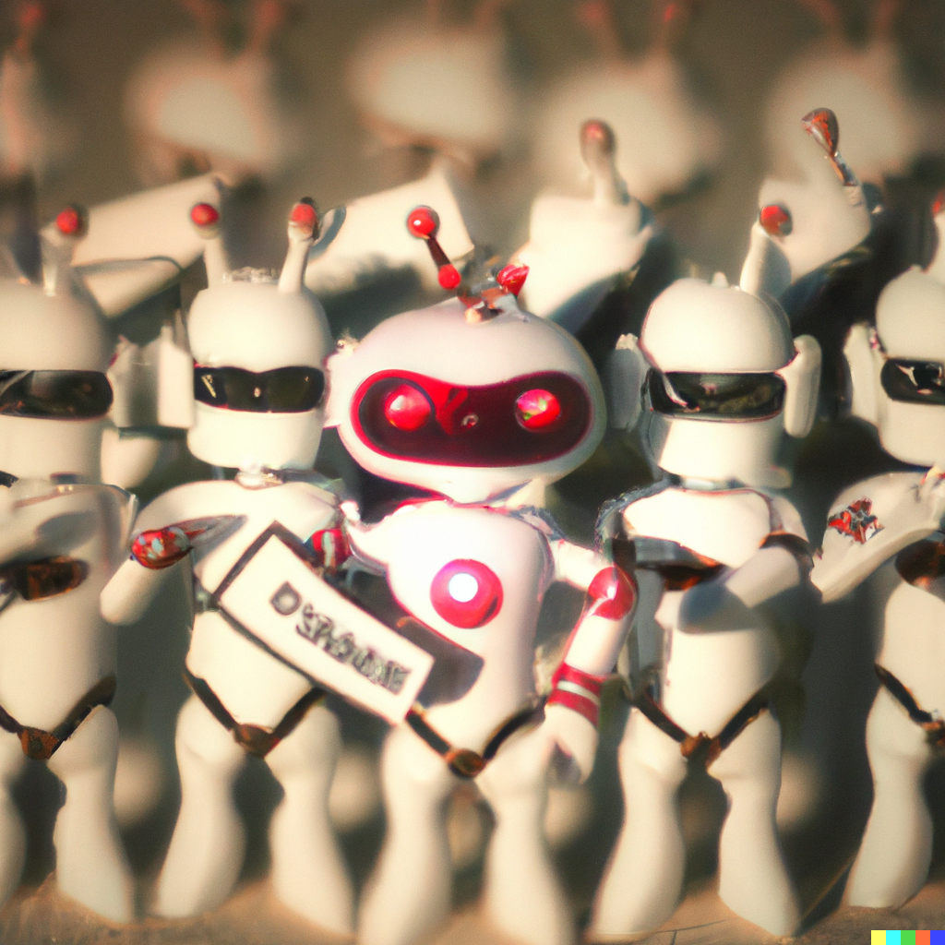
A bit of fun - AI Poetry for PRs
Oh, we're the crew who code the bot, and we're the best you'll ever see
We review the changes in the files, with a fileIndex for each
We heave and ho and pull the rope, and make the locators neat
We're the crew who code the bot, and we're the pride of the fleet
Command line prbot-engine
Added for automation ease
Springtime coding bliss #!
We unleash the prbot, the beast of AI
We measure its power, its skill and its price
We refine its language, its summaries and scores
We challenge the baseline, the human and the norms

Slide 46
Summarizations: From PRs to Entire Repos

Slide 47
Final outputs
Repository
Directory
Directory
File
File
File
File
Snippet
Snippet
Snippet
Snippet
Snippet

Slide 48
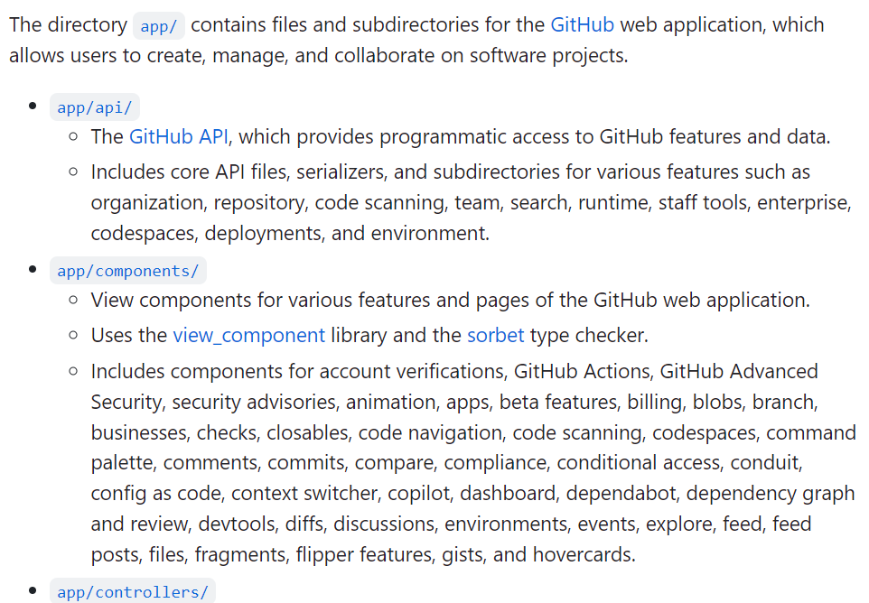
Hierarchical summaries of entire repositories
Overall summary of 1M+ LOC code in github/github “app” directory.
Every chunk, file, directory, issue, discussion gets a summary too.

Slide 49
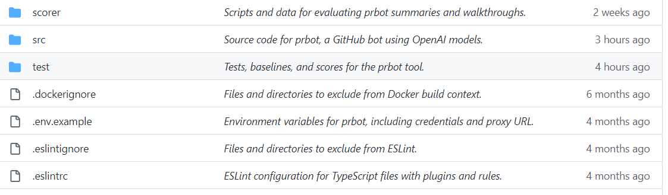
Surfacing in the UX

Slide 50
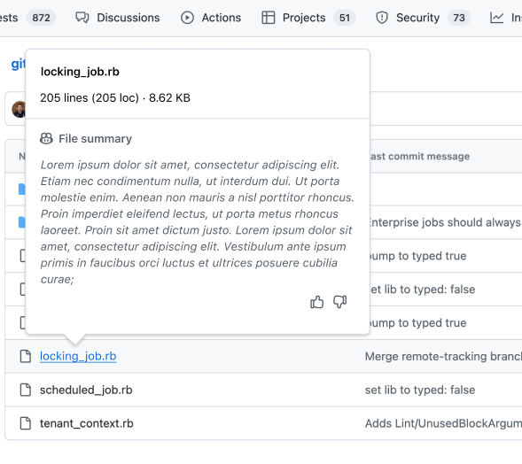
Surfacing in the UX

Slide 51
“Summarize all issues in this repo”
Final outputs
Issues
Issue
Issue
Description
Discussion
Description
Discussion
Chunk
Chunk
Comment
Comment
Comment

Slide 52
“Summarize discussions in this repo over last week”
Final outputs
ΔIssues
ΔIssue
ΔIssue
ΔDescription
ΔDiscussion
ΔDescription
ΔDiscussion
ΔChunk
ΔChunk
ΔComment
ΔComment
ΔComment

Slide 53
Thank you!
dsyme@github.com

Slide 54
From Code to Issues and more

Slide 55
Determining Hallucination Rates
This is hard
Subject Matter Experts must assess
Ran a “Hallucination Hunter” game internally to incentive experts to find hallucinations in descriptions of their own code
Very few in final summaries

Slide 56
RLA
RLA = Required Logical Accuracy
Same outputs have different RLA for different tasks!
Code Review = very high RLA
“A Quick Overview” for the Newcomer = medium RLA
Poem = low RLA
UX really matters, can reduce RLA

Slide 57
Summarize all the things
Code ⇒ Summary (“Explain this code” in Copilot VS Code)
PR ⇒ Summary (Copilot for PRs)
File ⇒ Summary
Directory ⇒ Summary
Issue ⇒ Summary
Discussion ⇒ Summary
Repo => Summary
(multiple AI calls needed == hierarchical summarization)

